Slide 1
Easier building with Spike prime
BY SANJAY AND ARVIND SESHAN

Slide 2
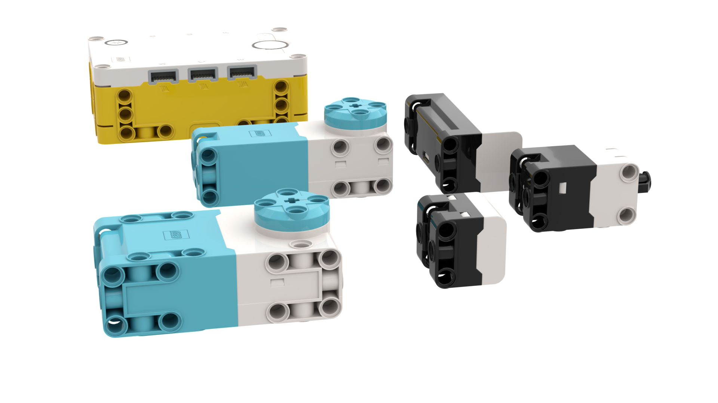
Square Form factors
The Hub, motors and sensors are all squares with Technic pin holes on all sides. This makes them easy to build with.

Slide 3
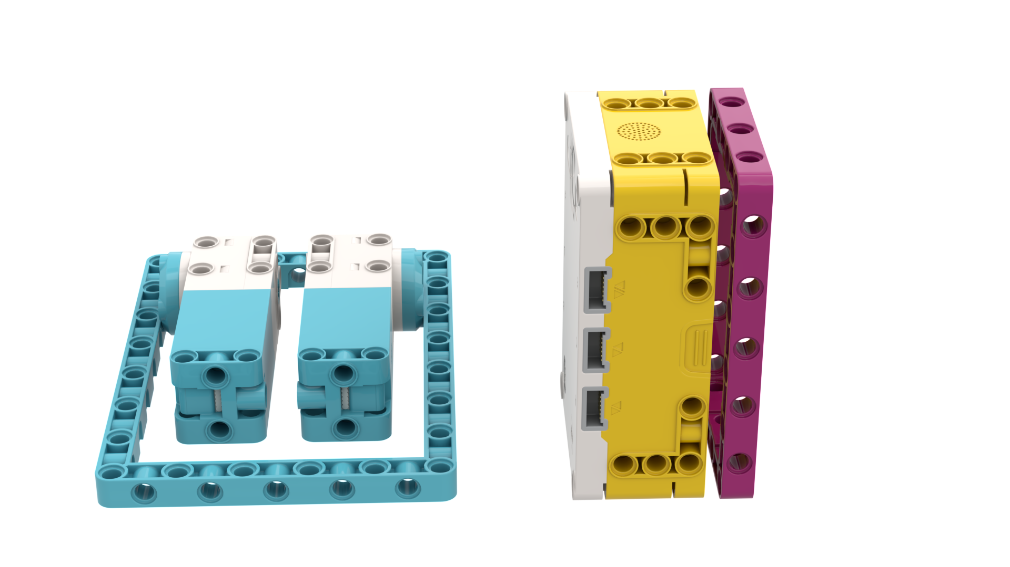
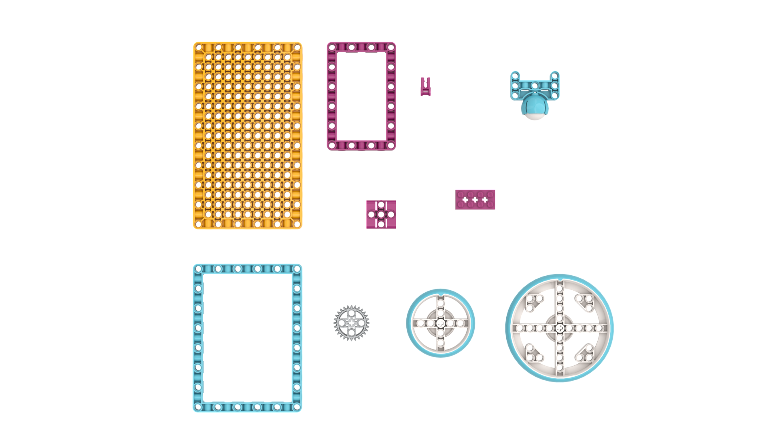
TECHNIC FRAMES (39794 and 39790)
Large Technic frames allows for faster and stronger building
The magenta frame is 11 X 7, The azure frame is 15 X 11

Slide 4
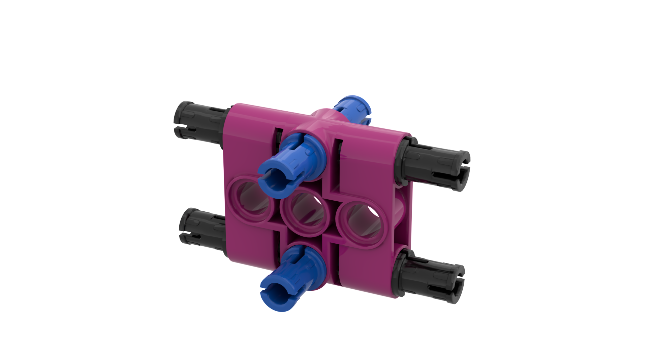
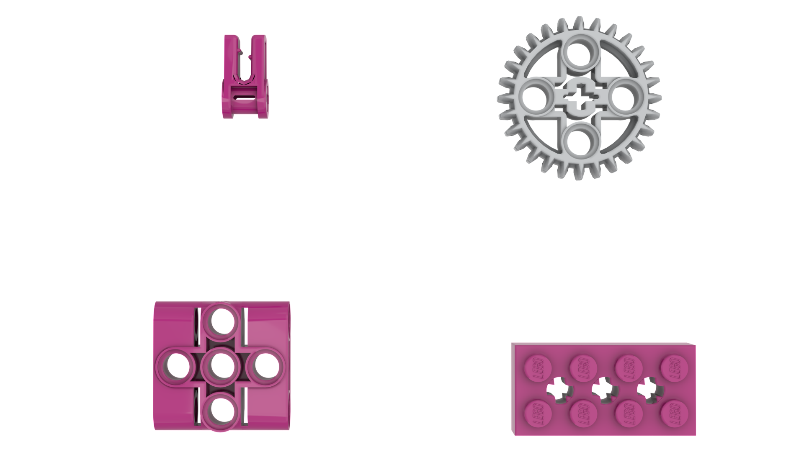
Biscuit (39793)
This 3X3 Technic element makes switching directions while building easy

Slide 5
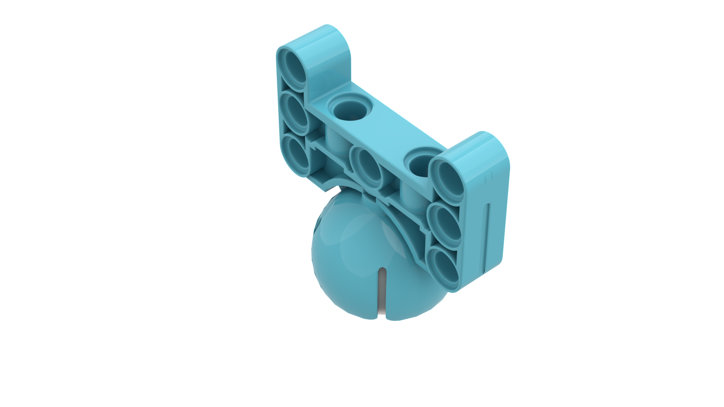
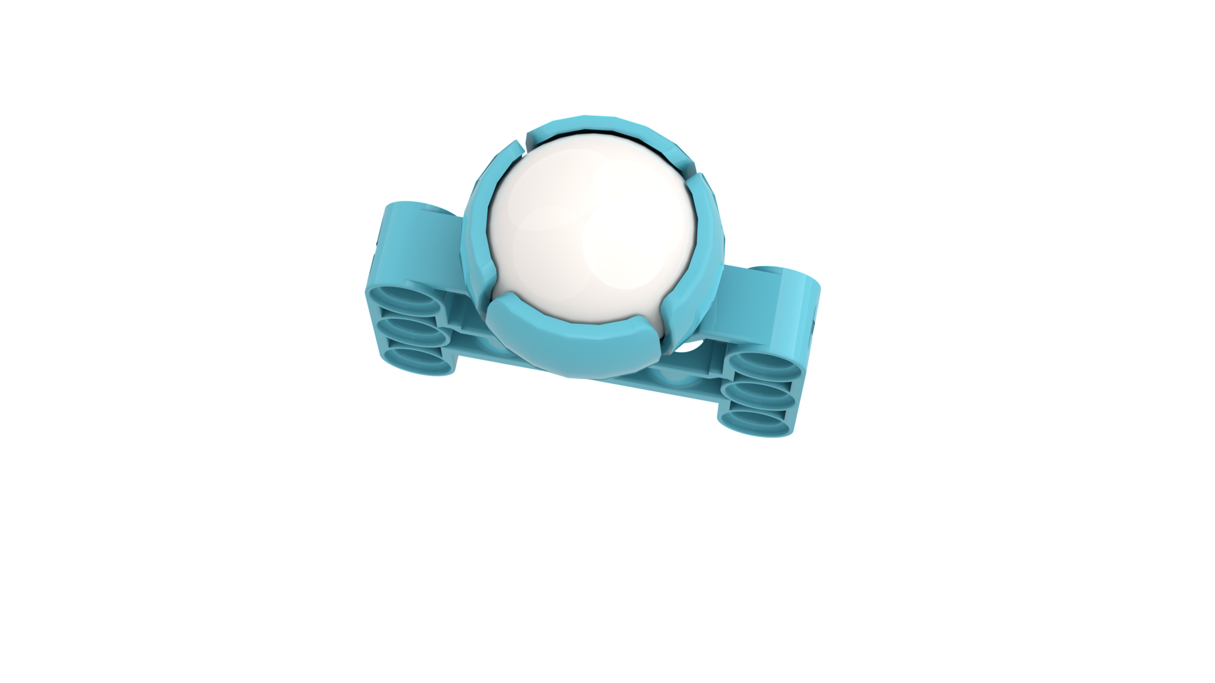
BALL and CASTOR (39370 and 52629)
Light-weight ball and castor
Ball will not rust
Unlike the EV3 ball and castor, there is no hole on the top to push out the ball.
To remove the ball, slide a thin string or piece of floss in one of the slots and make you way around the ball to the opposite slot. Pull on both ends of the string and ball should pop out.

Slide 6

WIRE CLIPS (49283)
These wire clips make wire management on your robot easier
Only one cable will fit in each clip
You get 12 clips in the SPIKE Prime set (2 in each color). You can use them to identify different parts of your robot. (e.g. Large motors can be green, Medium motors can be red, etc.)

Slide 7
WHEELS (39367 and 49295)
The rubber tire is molded on to the rim. Therefore they won’t slip off the rip as many LEGO tires do.
The small tire is 56 X14 (same size as the wheel in the EV3 Core set)
The large tire is 88 X 14

Slide 8
BEVEL GEAR (46372)
This new 28-tooth gear gives more options for gearing

Slide 9

Other new elements in spike prime
Technic Base Plate (39369): Base plate can be used for creating stable models
Integrator brick with cross axle (39789): Allows the builder to combine Technic with Systems brick

Slide 10
WHERE CAN I BUY these PARTs?
LEGO Parts Replacement: https://www.lego.com/en-us/service/replacementparts
SPIKE Prime Set – 45678
Inventory: https://le-www-live-s.legocdn.com/sc/media/files/support/spike-prime/le_spike_prime_set_element_overview_classroom_poster_18x24inch-a7ecd36fbf6d15fd4c7617f4cb882531.pdf
SPIKE Prime Expansion – 45680
Inventory: https://le-www-live-s.legocdn.com/sc/media/files/support/spike-prime/le_spike_prime_expansion_set_element_overview_classroom_poster_18x24inch-1ffffebb088c5875820d767462b0a1d3.pdf

Slide 11
CREDITS
This lesson was created by Sanjay Seshan and Arvind Seshan for SPIKE Prime Lessons
More lessons are available at www.primelessons.org
This work is licensed under a Creative Commons Attribution-NonCommercial-ShareAlike 4.0 International License.

